Slide 1
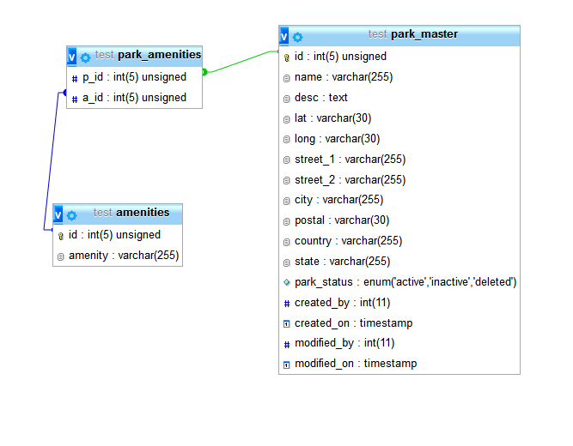
Update to database
The ‘amenities’ and ‘park_amenities’ tables were added to the DB schema in order to facilitate more succinct queries:

Slide 2
Implementation
The eCPAT web application will be developed using ASP.NET.
This is accomplished by having the ‘mono_mod’ package installed on the server which provides .NET support for Apache.
Use of ASP.NET will provide a more structured and straightforward development process without the need for additional tools to accommodate coding by convention.

